Slide 1

Lesson 2.2 : Nested loops
Microsoft Philanthropies TEALS Program
Introduction to Computer Science

Slide 2
After this lesson, you will be able to
Use nested loops to solve programming problems.

Slide 3
Today’s plan
Do now
Lecture
Lab
Debrief

Slide 4

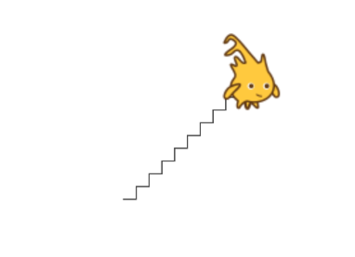
Do now 2.2
Go to the starter project. Reassemble the blocks so Alonzo asks how many zigzags to draw. Then have Alonzo draw zigzags from the center of the stage to the upper right the number of times specified.
Notes:
Do Now link - https://aka.ms/DoNow2.2
Prompt students to restate the definition of loop.
A type of block that causes other code to run multiple times in succession.
Prompt students to explain why loops are useful in programming.
To reduce code redundancy and increase readability when dealing with repetitive tasks.
Ask for examples of problems that can be solved with loops.
Drawing polygons, repeating an action, etc..
Ask students how their scripts to draw shapes improved when they introduced loops.
Code became shorter and more readable.
Small changes, such as altering the size of the shape, became simpler.

Slide 5

Multiple squares
How would you draw two squares next to each other?
Notes:
Ask students to consider the problem of drawing two squares next to each other. Work through writing a script to do this. The likely result will duplicate the code to draw a single square:
(Remind students to remember what they previously learned and use loops)

Slide 6
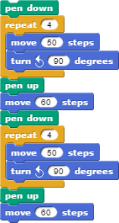
Are there ways to improve the code?
How would you modify the code to draw 10 squares?
100 squares?
An unknown number of squares?
Can loops somehow be applied to reduce redundancy even further in the script to draw two squares?
Notes:
Once the script is complete, ask students if there are ways they could improve the code
Discuss what would happen if you needed to draw 10 squares, or 100, or an unknown number.
If students seem capable, you can allude to user input for the unknown number example, but do not get into details at this point
Ask if loops can somehow be applied to reduce redundancy even further in the script to draw two squares

Slide 7
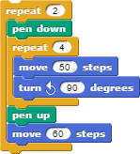
Nested loops
A loop used inside the body of another loop.
The body of a loop can contain any code, including another loop.
The inner loop will run all its iterations each time the outer loop runs.
How many total times does the sprite will move 50 steps?
The sprite will move 50 steps 8 times (4 * 2)
Notes:
Introduce the concept of nested loops
Define nested loop - a loop used inside the body of another loop.
Point out that there is nothing particularly special happening here-- the body of a loop can contain any code, including another loop
Emphasize that the inner loop will run all its iterations each time the outer loop runs.
Walk through rewriting the script to draw multiple squares to use nested loops:
Ask how many total times the sprite will move 50 steps
(Answer) The sprite will move 50 steps 8 times (4 * 2)
Show that the number of squares drawn can be easily changed by simply changing the number of times the outer loop iterates

Slide 8

Lab 2.2
In this lab, you will use nested loops to draw a yellow brick road using as little code as possible.
Part 1: Single Brick Road
Part 2: Multiple Rows of Bricks
Notes:
Direct students to complete the Yellow Brick Road activity individually or in pairs. Try to pair students that have not previously interacted.
Remind students to continue using the principles learned with basic loops
Encourage students to write scripts that are as short and succinct as possible while still being functional and readable

Slide 9

2.2: Debrief
Notes:
Show a student's solution
-Either request a volunteer or cold call alternative
-Point out uses of nested loops
Ask students to describe how loops, specifically nested loops, made the assignment easier
-Each brick, or at least each row, would have needed to be coded separately creating much longer scripts
Ask students to think about what code would need to change to alter the size of each brick or the size of the road and how that was made easier with loops
-Size of road: number of iterations in one or both loops
-Size of brick: one or both move blocks and number of iterations in one or both loops
-Without loops, the change would have been needed in many different places

Slide 10

Exit ticket
In your notebook, write down what was challenging about this lab.

